Slide 1
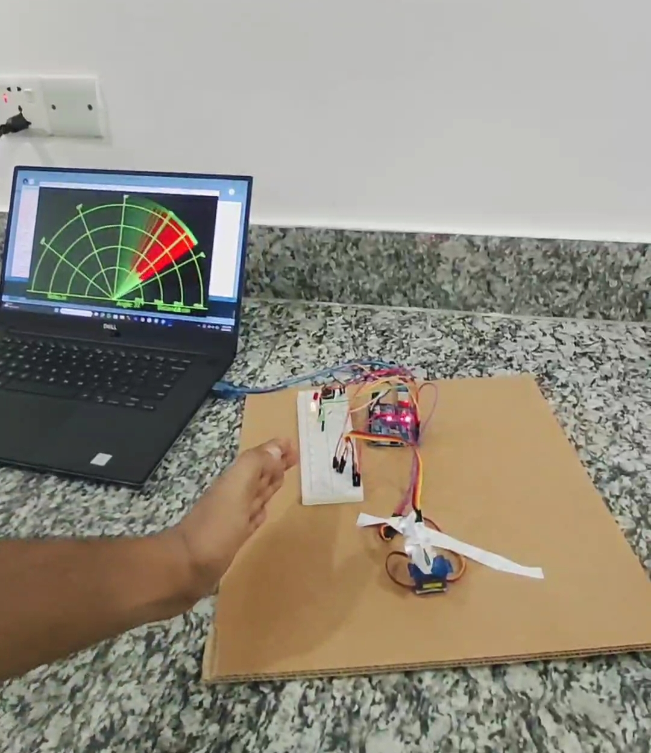
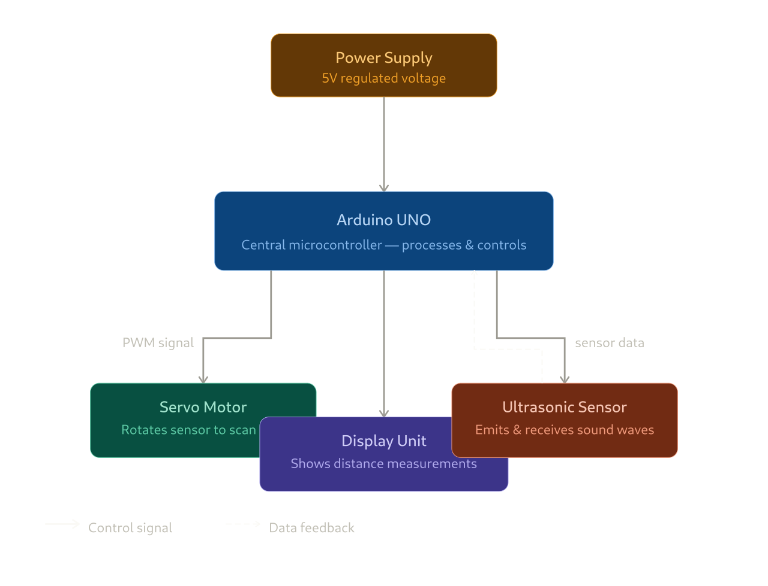

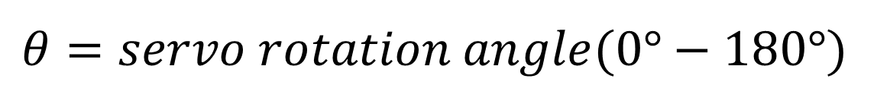
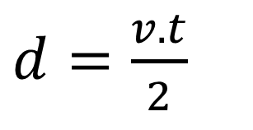
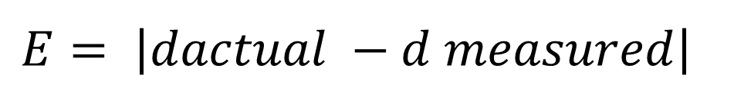
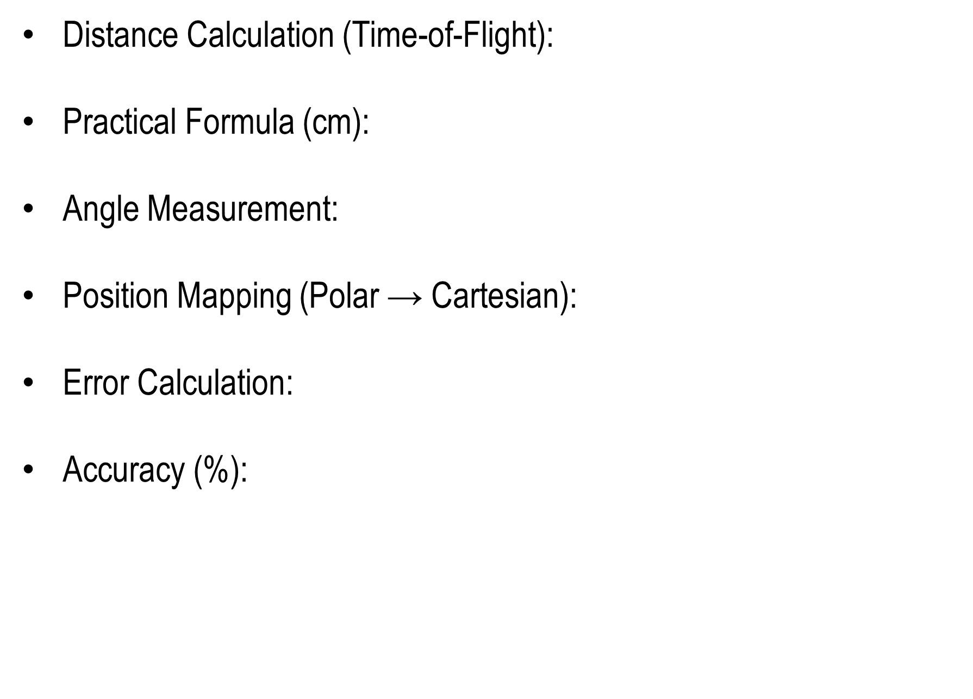
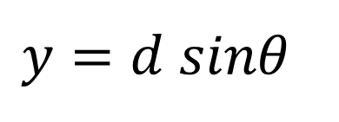
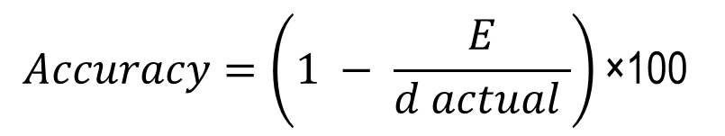

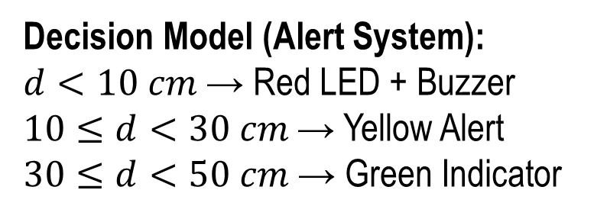
Paper ID # 13
Development of an Arduino-Based RADAR System for Object Detection and Distance Measurement
MD. Abdullah Anas, Abul Bashar Saurov, MD. Samiul Alim Safayet, Lubna Akhter, Osama Mobin Zuhar and Muhibul Haque Bhuyan
American International University-Bangladesh (AIUB), Dhaka, Bangladesh
Aims and Objectives
Designed Prototype
To design and develop a low-cost Arduino-based RADAR system.
To detect objects within a short-range environment (2–400 cm) .
To measure object distance with acceptable accuracy.
To visualize detected objects using angle-based scanning.
To implement an alert system using a buzzer for nearby objects
Compact hardware setup using Arduino Uno.
Sensor mounted on rotating servo motor.
Real-time scanning of surroundings.
Visual output displayed on computer screen.
Audio alert system integrated with buzzer
Methodology for Achieving Goal
Hardware components: Arduino Uno, HC-SR04 ultrasonic sensor, servo motor, led, buzzer.
System powered using a 9V battery.
Servo motor rotates sensor from 0° to 180° .
Ultrasonic sensor sends and receives echo signals.
Distance calculated using time-of-flight principle.
Arduino processes data and sends output to IDE/Processing.
Buzzer activates when object is detected within threshold distance
Data Table/Experimental Design
Trial No. | Actual Distance (cm) | Measured Distance (cm) | Error (cm) | Accuracy (%)
1 | 50 | 49 | 1 | 98%
2 | 100 | 101 | 1 | 99%
3 | 150 | 149 | 1 | 99.3%
4 | 200 | 198 | 2 | 99%
5 | 250 | 253 | 3 | 98.8%
6 | 300 | 304 | 4 | 98.6%
7 | 350 | 355 | 5 | 98.5%
8 | 400 | 397 | 3 | 99.2%
Simulation Results
Conclusion and Future Works
Conclusion:
Developed a functional low-cost RADAR system.
Achieved reliable short-range object detection.
System is simple, scalable, and efficient.
Suitable for educational and basic automation purposes
Future Works:
Use multiple sensors for 360° coverage.
Improve detection range using advanced sensors.
Integrate wireless communication (IoT).
Apply in autonomous vehicles or smart security systems.
Enhance visualization with better UI
Mathematical Model
$d=\frac{v. t}{2}$
Distance Calculation (Time-of-Flight):
Practical Formula (cm):
Angle Measurement:
Position Mapping (Polar → Cartesian):
Error Calculation:
Accuracy (%):
where v=343 m/s t = echo time
$d(cm)=\frac{t}{58}$
Acknowledgement
$$θ=servo rotation angle(0°−180°)$$
The authors of this paper recognize the contribution of the American International University-Bangladesh for their financial support for purchasing the necessary tool for the Lab under the EEE Department and for providing the conference grant.
$x=d cosθ$,
$$y=d sinθ$$
References
$$E= \left|dactual −d measured\right|$$
[1] A. D. Droitcour et al., IEEE Transactions on Microwave Theory and Techniques, 52(3), 838–848, (2004).
[2] C. Li et al., IEEE Transactions on Microwave Theory and Techniques, 58(5), 1410-1419, (2010).
[3] G. T. Bharathy et al., International Journal of Scientific Research in Science, Engineering, and Technology, 9(8), 38-47, (2021).
[4] N. Zhu et al., International Radar Conference (IET IRC 2020), 96-101, (2021).
[5] N. K. Paul et al., Journal of Engineering Research and Reports, 24(11), 1-13, (2023).
[6] M. U. Islam et al., Turkish Journal of Computer and Mathematics Education, 15(3), 25-34, (2024).
$$Accuracy=\left(1 − \frac{E}{d actual }\right)\text{×100}$$
Decision Model (Alert System):
$d<10 cm$ → Red LED + Buzzer
$10≤d<30 cm$ → Yellow Alert
$30≤d<50 cm$ → Green Indicator

